Slide 1

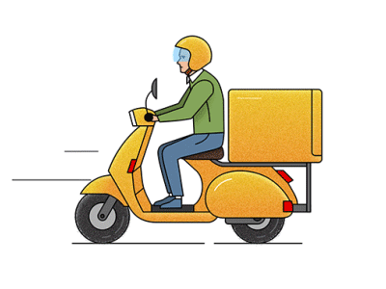
Last-Mile Delivery Operations Analytics

Slide 2


About
Me
A quick introduction, interests & data science journey
Zeeshan Mirza
Team Leader
Computer Science graduate and aspiring Data Science professional with an interest in Python programming, data analytics, and web development. Passionate about learning new technologies and building practical solutions.
Education
Computer Science Graduate with an academic foundation in programming, computer fundamentals, and software development. Currently exploring Data Science and software development.
Experience
Fresher
Why you want to learn Data Science ?
I want to learn Data Science to understand how data can be used to solve real-world problems and support better decision-making. I aim to develop my skills in Python, SQL, data analysis, and visualization while exploring Artificial Intelligence and Machine Learning to turn complex data into meaningful insights and solutions.
Linked in
GitHub

Slide 3
About
Me
A quick introduction, interests & data science journey
Abhishek Kumar
Team Member
Driven Data Science professional proficient in Python, SQL, and data visualization. Experienced in developing end-to-end machine learning models and leveraging quantitative analysis to solve real-world business challenges.
Education
Pursued a B.Tech in CSE (Data Science), building a strong foundation in core software concepts. This is backed by technical expertise in Power BI visualization, and building basics NLP or GenAI solutions using Python, SQL.
Experience
Fresher
Why you want to learn Data Science ?
I want to learn and pursue Data Science because it bridges my strong engineering foundation with the power to solve real-world problems using data-driven insights. Having pursued a B.Tech in CSE with a specialization in Data Science, transitioning into this field is a natural progression to build upon my technical expertise.
Linked in
GitHub

Slide 4
About
Me
A quick introduction, interests & data science journey
Manoj Kumar Sahu
Team Member
MCA graduate & presentation expert with professional experience in high-end
power point design skilled at bridging the gap between technical data and visual storytelling.
Education
MCA Graduate specialized in computer applications and data analysis.
Experience
2 years as a Presentation Specialist, skilled in PowerPoint, think-cell, Efficient Elements, and Data Visualization
Why you want to learn Data Science ?
With my MCA background and 2 years of experience as a Presentation Specialist, I want to move beyond presenting data to analyzing and extracting insights from it. Learning Data Science will help me build a stronger technical career, explore better opportunities, and grow into a data-driven role.
Linked in
GitHub

Slide 5
Project Overview
Business Scenario
Business Objectives
Dataset & Database Overview
ER Diagram & Database Structure
Analysis of the Objectives
Overall Key Findings
Business Recommendations
Conclusion
Q&A
Table of contents

Slide 6
Project Overview
Core Objective :
Optimize last-mile delivery operations and resource efficiency for QuickRoute Logistics using data-driven SQL insights.
Performance Metrics:
Evaluated average transit distances (km), delivery durations (minutes), and fulfillment timelines across different service types.
01
04
Database Setup:
Designed 5 relational MySQL tables containing 7,030 total records across customers, orders, drivers, vehicles, and deliveries.
Resource Utilization:
Monitored driver performance ratings, active status constraints, and fleet utilization across distinct vehicle and fuel types.
02
05
Demand & Behavior:
Tracked monthly ordering trends, zone-based demand volumes, and customer profiles partitioned by type (Business vs. Individual).
Problem Bottlenecks:
Isolated operational friction by auditing multi-attempt shipments, pending statuses, and high failed-delivery percentages per zone.
03
06

Slide 7
Business Scenario
Connecting the real-world logistics story to our MySQL database structure.
Who & What (The Real Story)
Customers place delivery orders across different zones, and our drivers use company vehicles to transport and drop off the packages
How the data connects
01
Who
Customer & Driver
How (The MySQL Database)
We link 5 relational data tables together (Customers, Orders, Deliveries, Drivers, and Vehicles) to track every step of a package's journey.
02
What
Order & Vehicle
Why (The Business Goal)
To easily spot late packages, fix failed delivery runs, lower overall shipping costs, and keep our customers happy.
03
How & Why
MySQL Actionable Insights

Slide 8





Business Objectives
Understand Delivery Demand
Order volumes by delivery zone, service type, priority, time, and order value.
Understand Customer Order Behaviour
Order frequency, high-value customers, customer activity by zone, Business vs. Individual customers, and ordering patterns over time.
Evaluate Delivery Performance
Delivery outcomes by zone and status, delivery duration, activity levels, and performance over time.
Understand Driver and Vehicle Performance
Deliveries handled by drivers, driver outcomes and durations, vehicle-type usage, and vehicle-level performance.
Identify Delivery Problems
Multiple delivery attempts, common status patterns, performance of multi-attempt deliveries, and zones with more delivery problems.

Slide 9






Dataset & Database Overview
Customers
Orders
Deliveries
Drivers
Vehicles
400
3,000
3,500
80
50
Customers profiles & delivery zones
Order details, service type, priority and value
Delivery status, attempts, distance and duration
Ratings, employment type and availability
Vehicle type, fuel type and capacity
Database Structure
Purpose
5 relational tables
Analyse delivery demand
Orders link customers to deliveries
Understand customer behaviour
Deliveries link orders with drivers and vehicles
Evaluate delivery performance
Assess resource utilization
Identify operational issues

Slide 10
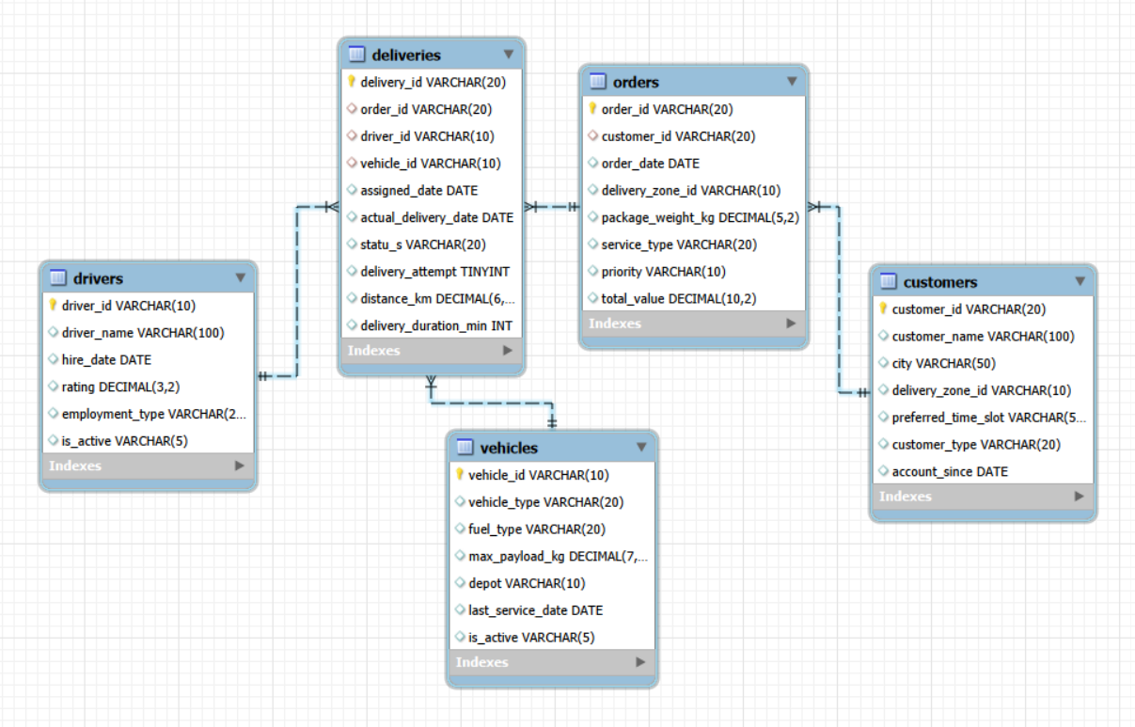
ER Diagram & Database Structure
Database Relationships
Customers → Orders:
One customer can place multiple orders.
Orders → Deliveries:
One order can have multiple delivery records.
Drivers → Deliveries:
Each delivery record references a driver.
Vehicles → Deliveries:
Each delivery record references a vehicle.

Slide 11




Objectives 1 - Understand Delivery Demand
3,000
Total Orders
7.52M
Total Order Value
2,507.47
Average Order Value
1,229
Orders in 2024
Key Metrics Comparison
Demand Growth: Orders increased from 608 (2022) to 1,229 (2024), more than doubling.
Top Delivery Zone: ZONE0005 recorded the highest demand with 240 orders.
Popular Service: Standard recorded the highest order volume with 620 orders.
Service Value: Same Day had the highest average order value at 2,633.93.
Order Priority: High-priority orders led with 1,035 orders (34.5%).
Peak Month: December recorded the highest monthly order volume with 293 orders.
Zone Distribution: ZONE0007 recorded the lowest demand with 79 orders.
Key Findings
Metric | Value | Details
Total Orders | 3,000 | Overall orders in dataset
Total Order Value | 7.52M | Total Order Value from all orders
Average Order Value | 2,507.47 | Average value per order
Orders in 2024 | 1,229 | Orders placed in 2024
Top Delivery Zone | ZONE0005 | Highest demand with 240 orders
Popular Service Type | Standard | Highest order volume with 620 orders
Highest Avg. Order Value | Same Day | 2,633.93 average order value
Top Order Priority | High | 1,035 orders (34.5%)
Peak Month | December | Highest monthly order with 293 orders
Lowest Delivery Zone | ZONE0007 | Lowest demand with 79 orders
1
2
3
4
5
6
7

Slide 12


Objectives 2 - Customer Order Behavior
400
Total Customers
3000
Total Orders
397
Repeat Customers
Key Metrics Comparison
Out of 400 customers, 273 are Individual and 127 are Business customers.
Individual customers placed 2,050 orders (68.3%), while Business customers placed 950 orders (31.7%).
397 out of 400 customers placed multiple orders, indicating high repeat activity.
Business customers have a higher average order value (2,572.70) compared to Individual customers (2,477.24).
Individual customers contribute the highest total order value (5.08M) compared to Business customers (2.44M).
Overall, Individual customers drive order volume, while Business customers generate higher value per order.
Key Findings
Metric | Individual | Business
Customers | 273 | 127
Orders | 2,050 | 950
Order Share | 68.3% | 31.7%
Average Order Value | 2,477.24 | 2,572.70
Total Order Value | 5.08M | 2.44M
1
2
3
4
5
6

Slide 13


Objectives 3 - Evaluate Delivery Performance
3,500
Delivery Records
73.7%
Delivered Records
295
Failed Deliveries
47 Minutes
Average Delivery Duration
Delivery Performance Comparison
3,500 delivery records analyzed, with 73.7% successfully delivered.
295 deliveries (8.4%) failed to be delivered.
624 records were pending or rescheduled (17.8% combined).
Express service has the best performance with 76.9% delivered records.
Economy service has the highest failure share at 10.8%.
ZONE0003 recorded the highest failure rate at 11.9%.
Average delivery duration is approximately 47 minutes across all delivery records.
Key Findings
Metric | Value | Details
Total Delivery Records | 3,500 | All delivery records in dataset
Delivered Records | 2,581 (73.7%) | Successfully delivered orders
Rescheduled Records | 318 (9.1%) | Orders rescheduled for later delivery
Pending Records | 306 (8.7%) | Orders still pending delivery
Failed Deliveries | 295 (8.4%) | Orders that could not be delivered
Best Performing Service | Express (76.9%) | Highest delivered share
Highest Failure Service | Economy (10.8%) | Highest failure share
Zone with Highest Failure Rate | ZONE0003 (11.9%) | Highest identified failure rate
Average Delivery Duration | 47 minutes | Average time to complete delivery
1
2
3
4
5
6
7

Slide 14


Objectives 4 - Driver & Vehicle Performance
80
Total Drivers
75
Active Drivers
50
Total Vehicles
3.05
Average Driver Rating (out of 5)
Driver & Vehicle Comparison
80 drivers in total, with 75 active (93.75%) and 5 inactive (6.25%).
50 vehicles, and all are marked active in the dataset.
The average driver rating is 3.05 out of 5.
Contract drivers recorded the highest failure rate at 10.04%.
Trucks recorded the lowest failure rate at 6.42%.
Electric vehicles had the highest delivered-record share at 74.57%.
Key Findings
Metric | Value | Details
Total Drivers | 80 | 75 active, 5 inactive
Active Drivers | 75 (93.75%) | Drivers currently active
Inactive Drivers | 5 (6.25%) | Drivers not active
Total Vehicles | 50 | All vehicles active
Active Vehicles | 50 (100%) | Vehicles available for delivery
Average Driver Rating | 3.05 | Out of 5
Highest Failure Employment Type | Contract (10.04%) | Highest delivery failure rate
Lowest Failure Vehicle Type | Truck (6.42%) | Lowest delivery failure rate
Highest Delivered Share Fuel Type | Electric (74.57%) | Highest delivered-record share
1
2
3
4
5
6

Slide 15


Objectives 5 - Identify Delivery Problems
919
Non-Delivered Records
925
Orders Without Delivery Record
26.3%
Non-Delivered Share
2,075
Orders With Delivery Records
Delivery Problems Comparison
919 deliveries are non-delivered. 318 rescheduled - 306 pending - 295 failed.
925 orders have no delivery record. 30.8% of the 3,000 orders.
26.26% of delivery records (919 of 3,500) are not marked Delivered.
Some orders need repeated attempts. Up to 6 delivery records per order.
919 non-delivered records lack an actual date. Indicates incomplete delivery tracking.
ZONE0003 has the highest failure rate. 11.9% among analyzed zones.
Key Findings
Metric | Value | Details
Total Delivery Records | 3,500 | All delivery records
Non-Delivered | 919 (26.3%) | 318 rescheduled - 306 pending - 295 failed
Orders Without Delivery | 925 (30.8%) | No matching delivery record
Pending Deliveries | 306 | Still awaiting completion
Failed Deliveries | 295 | Delivery attempt marked failed
Rescheduled Deliveries | 318 | Delivery required rescheduling
Max Records per Order | 6 | Multiple delivery records
No Actual Delivery Date | 919 | No date for non-delivered records
Highest Failure Zone | ZONE0003 (11.9%) | Highest analyzed failure rate
1
2
3
4
5
6

Slide 16







Overall Key Findings
Growing Demand
Business Value
Customer Behaviour
Annual orders increased from 608 in 2022 to 1,229 in 2024.
3,000 orders generated a total order value of 7,522,414.78, with an average order value of 2,507.47.
Individual customers contributed 68.3% of orders, while business customers contributed 31.7%.
Delivery Performance
Service Insight
Data-Tracking Gaps
2,581 of 3,500 delivery records were marked Delivered (73.74%).
Same Day service had the highest average order value (2,633.93), while Standard service had the lowest failure rate (6.4%).
925 orders (30.83%) had no matching delivery record, requiring further investigation.
QuickRoute shows growing demand, a strong customer base, and valuable business insights, with opportunities to improve delivery performance and data tracking.
Key Takeaway

Slide 17
Business Recommendations
Some zones get far more orders
Add drivers and vehicles there
Check zones with the most failed deliveries
Find the busiest days and months
Put more drivers on those days
Keep the team lean on quiet days
Call or SMS the customer before delivery
Deliver in their preferred time slot
Fewer repeat trips, lower cost
Fix busy zones
Plan for busy days
Deliver on the first try
1
2
3
Find the top 10 customers by spending
Give them one dedicated contact
Offer deals to repeat buyers
Compare earnings of each service type
Long or slow trips need higher prices
Raise the price where we lose money
Coach drivers with late or failed deliveries
Send heavy parcels in bigger vehicles
Reward top-rated drivers
Keep our best customers
Price services right
Use drivers and vehicles well
4
5
6

Slide 18



Conclusion
Growing, Loyal Demand
Delivery Opportunity
Data Gaps
Orders more than doubled from 608 (2022) to 1,229 (2024). 397 of 400 customers reordered; Individuals bring 68.3% of orders, while Business spends more per order.
73.7% of 3,500 records were delivered, but 8.4% failed and 17.8% are pending or rescheduled. Failures cluster in Economy (10.8%), ZONE0003 (11.9%) and Contract drivers (10.04%).
925 orders (30.83%) have no matching delivery record, so some performance numbers may be understated or incomplete.
Next Steps
1
Fix busy zones
2
Deliver first time
3
Coach and match
4
Close the gap
Add drivers and vehicles in the busiest zones and peak months.
Confirm delivery slots
with customers to improve
first-attempt success.
Coach drivers with high failure rates; match vehicles to parcel size.
Link every order to a delivery record so tracking is complete.
QuickRoute has the demand and the customers. Fixing first-attempt delivery and data tracking is the quickest way to cut costs and make the service more reliable.
Final Takeaway

Slide 19

THANK YOU

